Slide 1
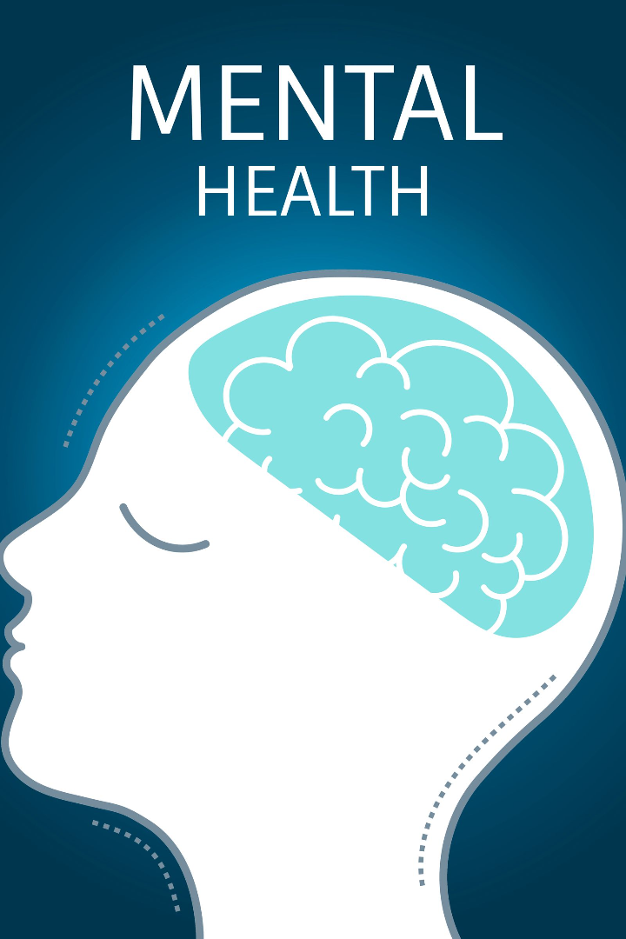
MentoBliss: Mental Stress Detection and Care
Welcome to our revolutionary app that aims to detect and provide care for mental stress. Explore our unique approach utilizing technology and a strong support network.

Slide 2

Problem Statement
Mental stress has become a widespread issue, affecting millions of people globally.
The lack of awareness and timely intervention often leads to prolonged mental stress, impacting individuals' overall health and productivity. The need for accessible and proactive mental health solutions has never been more critical.
Our app aims to address this problem by providing a comprehensive platform for stress detection and care.

Slide 3

Our Approach
We take a holistic approach to mental health by combining the following –
1. Research and Planning:
Conduct thorough research on mental stress, symptoms, and relevant factors.
Considering legal and ethical aspects related to mental health applications.
2. Application Development:
Train and validate the stress detection model.
Design an intuitive User Interface (UI) and User Experience (UX) with seamless integration of features.
Providing assistance to handle mental stress.
3. Collaboration:
Collaborate with mental health organizations, professionals, or academic institutions to enhance credibility and reach.

Slide 4
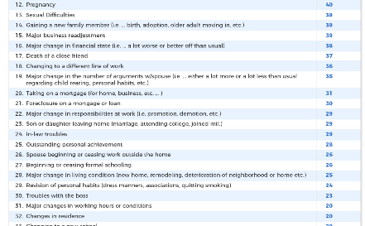


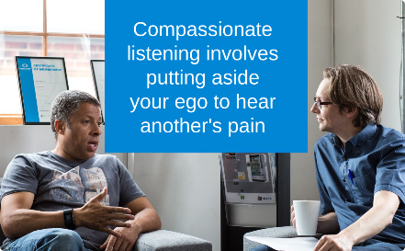
Key Features
Stress Level Detection
Educational Modules
Answer a series of questions to assess your stress level and receive personalized recommendations for managing stress.
Access a vast library of educational materials to enhance your knowledge and learn effective stress management techniques.
Mental Health Doctors
General Volunteers
Find and connect with mental health professionals near you for expert guidance and treatment options.
Talk to compassionate volunteers who are passionate about helping others and providing emotional support.

Slide 5
Key Features
Personalized Stress Level Detection
Access to Educational Modules
Empower yourself with evidence-based learning modules covering various topics related to stress management and mental well-being.
Our app employs intelligent algorithms to assess and track individual stress levels, enabling personalized care and support.
Connect with Mental Health Professionals
Talk to Compassionate Volunteers
Easily find and connect with qualified mental health doctors who can provide guidance and treatment options tailored to your needs.
Share your feelings and concerns with our supportive network of volunteers. Sometimes, a listening ear can make all the difference.

Slide 6
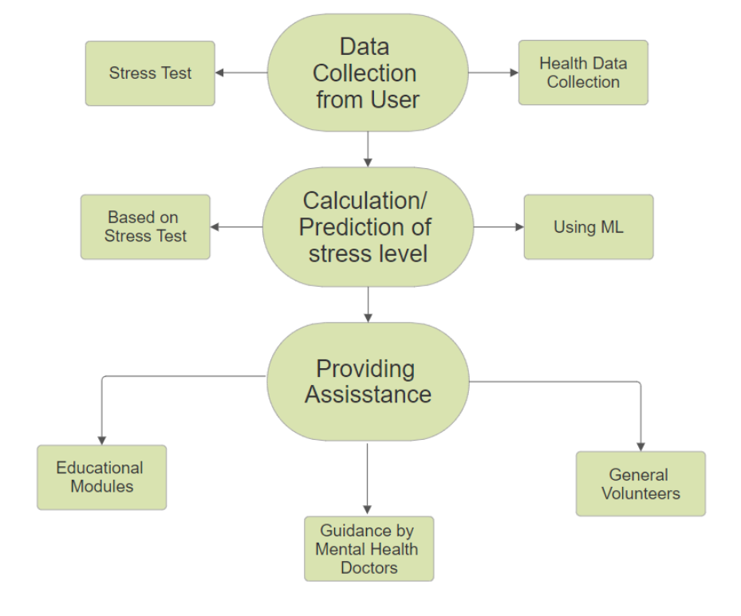
Process Flowchart

Slide 7


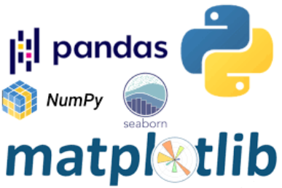
Technology Stacks
Android
Intuitive User Interface
Machine Learning
Firebase - For authentication and data storage.
Python, Numpy, Pandas, Matplotlib to process the data for training.
Animation, Gradient, style for interactive UI to offer a seamless and user-friendly experience.
API's for navigation - to provide uninterrupted navigation

Slide 8

Using Machine Learning for Stress Level Prediction
Our app leverages the power of machine learning algorithms to analyze user responses and predict stress levels. This enables us to offer personalized recommendations and interventions for effective stress management.
We collect data such as sleeping hours, heart rate, blood oxygen levels etc. from the user based on which the prediction of his/her stress level will be made.

Slide 9
Our Team
Name Branch Mentors :
1- Shaurya Jain CSE(AI&ML) 1- Sarthak Dubey
2- Ayush Srivastava CSE(AI&ML) 2- Garvit Singhal
3- Nayni Singhal CSE(AI&ML)
4- Dhruv Chaurasia CSE(AI&ML)
5- Vedanshi Kaushik CSE(AI&ML)
6- Archit Agrawal CSE(AI&ML)

